Slide 1

the
workshop

Slide 2
HOMEWORK REVISION.
1. Approach: group details in body paragraphs
[nhóm trends giống nhau & đan vào nhau]
[B1]: in person & telephones
Câu 1: (start from the highest)
In [1st year], [the data for type] was/stood at …
In …, … questions were sent to … via telephone
In …, tourists made … enquiries to …
Câu 2: so sánh với loại cùng nhóm vào body
This figure was … higher than that for [in person]
Câu 3&4: miêu tả trend loại cao nhất => loại kia.
[the data for type] …
***mỗi loại 1 câu trend
không chia bodies theo năm, chia theo loại/trend
[B2]: letter/email
Câu 1&2: Từ nối & Trend
2. Subjects:
The number of / the quantity of questions sent via [type].
The data/number for [type]
3. Paraphrase:
In person
Direct (face-to-face) communication | … meetings
Letter/email
Mailing | Mailed (written) questions/ enquiries/ queries.

Slide 3
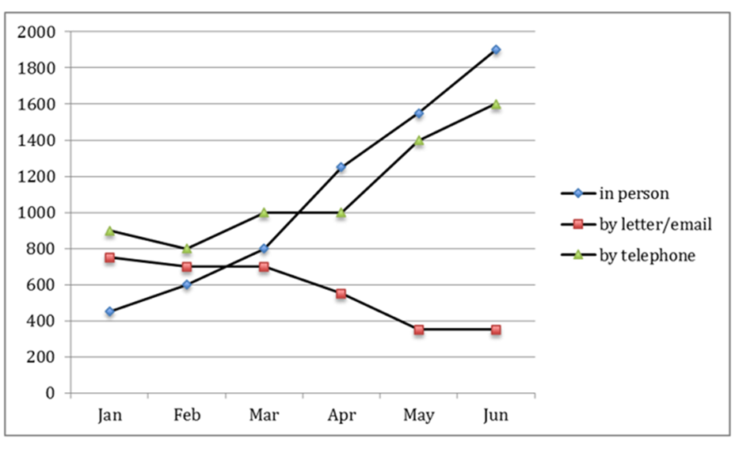
Question: The graph below shows the number of enquiries received by the Tourist Information Office
in one city over a six-month period in 2011
In January, the majority of questions were sent to the Office via telephones, at 900, almost doubling those sent in person. The total quantity of telephone queries dipped to 800 before climbing back/recovering to 1000 in March, at which point it plateaued for one month, and then surged to 1600 in June. Likewise, the number of direct questions jumped by 5 times/quintupled to approximately 2000 at the end of the period.
Notes:
Then/time/afterwards

Slide 4
Question: The graph below shows the number of enquiries received by the Tourist Information Office
in one city over a six-month period in 2011
Quite an opposite pattern can be observed in the data for written enquiries (On the other hand, there was a decrease in mailing preferences among tourists). After stabilizing at around 700 during the first quarter, this figure sank to just above under 400 in May when it remained static in the final month.
Notes:
Preference k liên quan đến nunber

Slide 5
Question: The graph below shows the number of enquiries received by the Tourist Information Office
in one city over a six-month period in 2011
The given line graph compares the number of questions sent to the Tourist Information Office in a particular city through three channels, namely telephones, mailing and direct communication, during the first half of 2011.
As can be seen from the graph, while there was a downward trend in the number of enquiries mailed to the Office, that of face-to-face meetings and telephone calls registered a noticeable increase.

Slide 6
Question: The graph below shows the number of enquiries received by the Tourist Information Office
in one city over a six-month period in 2011
The chart compares the number of enquires made to /questions sent to a Tourist Information Office in one city by three channels, namely telephone, letter/email and in person, in 2011
Overall, the figures for / number of questions via telephone and direct communication rose substantially/soared, whereas there was a gradual decline in that via letter/email / mailing preference over the timescale.
Trend: the period witnessed a noticeable climb in the number of telephone calls and meetings, while that of letter/email fell.

